Slide 1

CS4157
Software Quality
Notes:
CS5707 Software Development Paradigms
John Dawson
CS5707 Software Development Paradigms
John Dawson
CS5707 Software Development Paradigms
John Dawson
CS5707 Software Development Paradigms
John Dawson

Slide 2
Lecture Outline: Week 7 – 5th March
Software Metrics
Notes:
CS5707 Software Development Paradigms
John Dawson
CS5707 Software Development Paradigms
John Dawson
CS5707 Software Development Paradigms
John Dawson
CS5707 Software Development Paradigms
John Dawson

Slide 3
Last Week
Software Testing
Notes:
CS5707 Software Development Paradigms
John Dawson
CS5707 Software Development Paradigms
John Dawson
CS5707 Software Development Paradigms
John Dawson
CS5707 Software Development Paradigms
John Dawson

Slide 4
Lecture Outline
What are software metrics? / Why software metrics?
Problems with software metrics
Types / Examples of software metrics
Notes:
CS5707 Software Development Paradigms
John Dawson
CS5707 Software Development Paradigms
John Dawson
CS5707 Software Development Paradigms
John Dawson
CS5707 Software Development Paradigms
John Dawson

Slide 5
What are software metrics 1
An attempt to apply quantitative methods to measurement of (software) process or product quality
A measurement of the degree to which a process or product possesses a particular attribute
Notes:
CS5707 Software Development Paradigms
John Dawson
CS5707 Software Development Paradigms
John Dawson
CS5707 Software Development Paradigms
John Dawson
CS5707 Software Development Paradigms
John Dawson

Slide 6
What are software metrics 2
Standard classifications (Galin), two level:
Process & Product metrics
Quality, Timetable, Effectiveness & Productivity
Two common metrics:
KLOC: thousands of lines of code
Function points
Notes:
CS5707 Software Development Paradigms
John Dawson
CS5707 Software Development Paradigms
John Dawson
CS5707 Software Development Paradigms
John Dawson
CS5707 Software Development Paradigms
John Dawson

Slide 7
What are software metrics 3
Indirect Measurement 1
Software Metrics are usually indirect, in contrast to direct measurements (like weight or height etc.)
Indirect measurement raises the issue of representation, or what are we really measuring?
Example: Inflation measures prices – but what prices? Should we include (say) interest rates or the price of beer ... ?
In practice, the tendency is to make the thing we can measure the definition (like Inflation)
Notes:
CS5707 Software Development Paradigms
John Dawson
CS5707 Software Development Paradigms
John Dawson
CS5707 Software Development Paradigms
John Dawson
CS5707 Software Development Paradigms
John Dawson

Slide 8
Why software metrics 1
“You can't control what you can't measure” Tom DeMarco (1982)
Measurement of process and product quality, using traditional reviews, is both time-consuming and expensive
Hence, quantitative, preferably automated, measurement system might speed up the assessment process ... ?
Notes:
CS5707 Software Development Paradigms
John Dawson
CS5707 Software Development Paradigms
John Dawson
CS5707 Software Development Paradigms
John Dawson
CS5707 Software Development Paradigms
John Dawson

Slide 9
Why software metrics 2
Software metrics are a standard component of SPI models, examples:
A defining attribute of CMM level 4
The sixth Process Attribute of SPICE
Assessment is itself a type of metric ...
Notes:
CS5707 Software Development Paradigms
John Dawson
CS5707 Software Development Paradigms
John Dawson
CS5707 Software Development Paradigms
John Dawson
CS5707 Software Development Paradigms
John Dawson

Slide 10
Lecture Outline
What are software metrics? / Why software metrics?
Problems with software metrics
Types / Examples of software metrics
Notes:
CS5707 Software Development Paradigms
John Dawson
CS5707 Software Development Paradigms
John Dawson
CS5707 Software Development Paradigms
John Dawson
CS5707 Software Development Paradigms
John Dawson

Slide 11
Software metrics problems 1
Historically, software metrics have not been used to any great extent; possible reasons:
Lack of defined processes
Immature processes
Lack of standards
Notes:
CS5707 Software Development Paradigms
John Dawson
CS5707 Software Development Paradigms
John Dawson
CS5707 Software Development Paradigms
John Dawson
CS5707 Software Development Paradigms
John Dawson

Slide 12
Software metrics problems 2
Measuring what is easily measured, rather than what would be useful e.g.
Lines of code
Number of bugs
Lack of correlation between what is perceived and what is actually measured
Lack of standards and tools
Notes:
CS5707 Software Development Paradigms
John Dawson
CS5707 Software Development Paradigms
John Dawson
CS5707 Software Development Paradigms
John Dawson
CS5707 Software Development Paradigms
John Dawson

Slide 13
Software metrics problems 3
Inherent problems with software metrics:
Budgetary constraints on implementation and regular use, of software metrics
Resistance by staff to perceived job evaluation
Indirect nature of measurement
Other doubt over data validity
Notes:
CS5707 Software Development Paradigms
John Dawson
CS5707 Software Development Paradigms
John Dawson
CS5707 Software Development Paradigms
John Dawson
CS5707 Software Development Paradigms
John Dawson

Slide 14
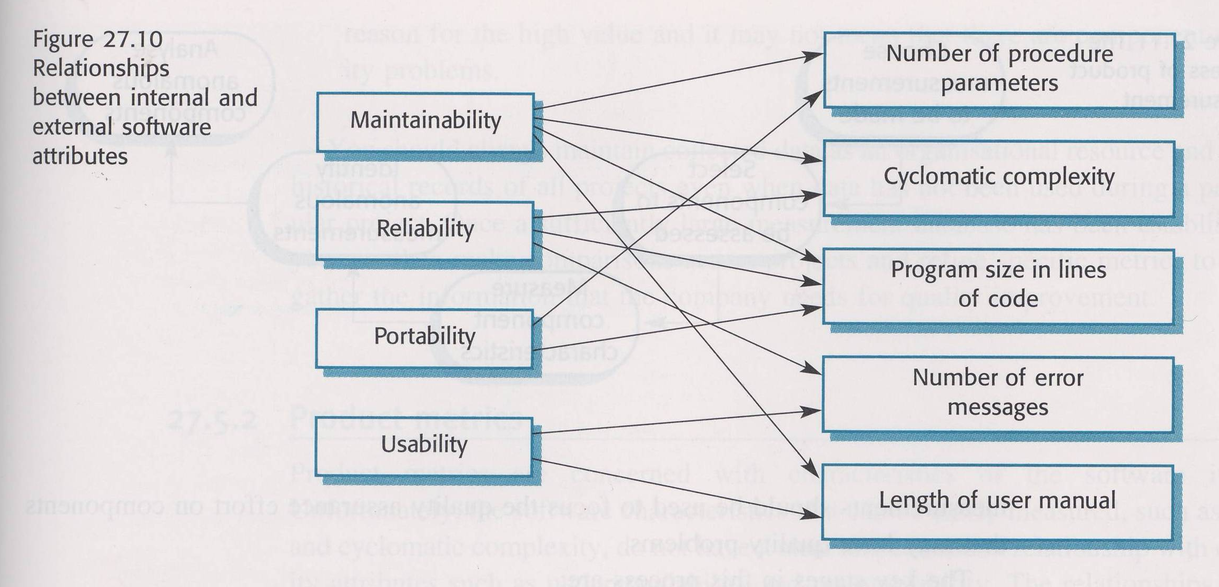
Software metrics problems 4
Notes:
CS5707 Software Development Paradigms
John Dawson

Slide 15
Lecture Outline
What are software metrics? / Why software metrics?
Problems with software metrics
Types / Examples of software metrics
Notes:
CS5707 Software Development Paradigms
John Dawson
CS5707 Software Development Paradigms
John Dawson
CS5707 Software Development Paradigms
John Dawson
CS5707 Software Development Paradigms
John Dawson

Slide 16
Software Metrics Taxonomy
Process Metrics
Quality: Bug density, severity, removal - effectiveness
Timetable: Achievement of milestones
Productivity: KLOC, function points, documents & reuse
Product Metrics
Dynamic: Excution time, response time, failures
Static: Fan-in / Fan-out (cohesion / coupling), module size, complexity measures, length of identifiers, nesting, Fog index – documents
Notes:
CS5707 Software Development Paradigms
John Dawson
CS5707 Software Development Paradigms
John Dawson
CS5707 Software Development Paradigms
John Dawson
CS5707 Software Development Paradigms
John Dawson

Slide 17
Software Metrics Example 1
Lines of code – KLOC; issues:
Language variability
Programmer variability
Inclusion of blank lines?
Inclusion of comments?
Perhaps more useful to think in terms of a maximum number of lines per function / module / method (100 lines?)
Notes:
CS5707 Software Development Paradigms
John Dawson
CS5707 Software Development Paradigms
John Dawson
CS5707 Software Development Paradigms
John Dawson
CS5707 Software Development Paradigms
John Dawson

Slide 18
Software Metrics Example 2
Number of bugs; issues:
Lack of correlation between severity and difficulty of fixing
Limiting case: performance bug ⇨ design changes
Might reflect thoroughness of testing better than any attribute of the software
A large number of bugs in a module might reflect its complexity more than its (un)reliability
Might matter more that bugs can be fixed (quickly) than how many there are
Might matter more that bugs stay fixed and fixing them doesn't cause more bugs ...
Notes:
CS5707 Software Development Paradigms
John Dawson
CS5707 Software Development Paradigms
John Dawson
CS5707 Software Development Paradigms
John Dawson
CS5707 Software Development Paradigms
John Dawson

Slide 19
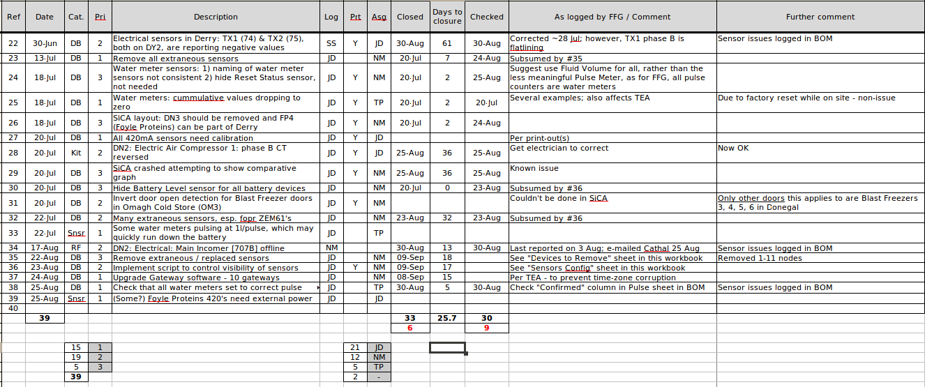
Example 1: Simple Spreadsheet Metrics
Notes:
CS5707 Software Development Paradigms
John Dawson

Slide 20
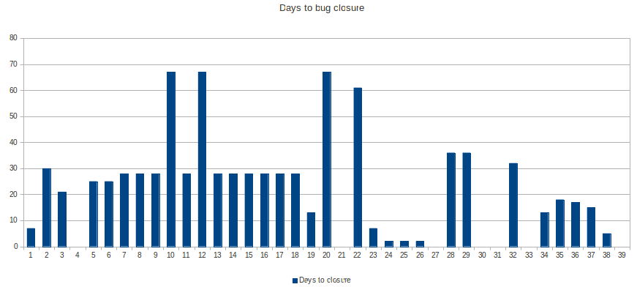
Example 2: Simple Spreadsheet Metrics
Notes:
CS5707 Software Development Paradigms
John Dawson

Slide 21
Reading
Daniel Galin (2003) Software Quality Assurance: From Theory to Implementation, Addison-Wesley, chapter 21
Sommerville, Ian (2006) Software Engineering (update) (8th edition), Addison-Wesley, chapter 27, section 5
Notes:
CS5707 Software Development Paradigms
John Dawson
CS5707 Software Development Paradigms
John Dawson
CS5707 Software Development Paradigms
John Dawson
CS5707 Software Development Paradigms
John Dawson

Slide 22
Next Week
Monday: Project Assignment
Thursday: Configuration Management
Notes:
CS5707 Software Development Paradigms
John Dawson
CS5707 Software Development Paradigms
John Dawson
CS5707 Software Development Paradigms
John Dawson
CS5707 Software Development Paradigms
John Dawson

